Slide 1
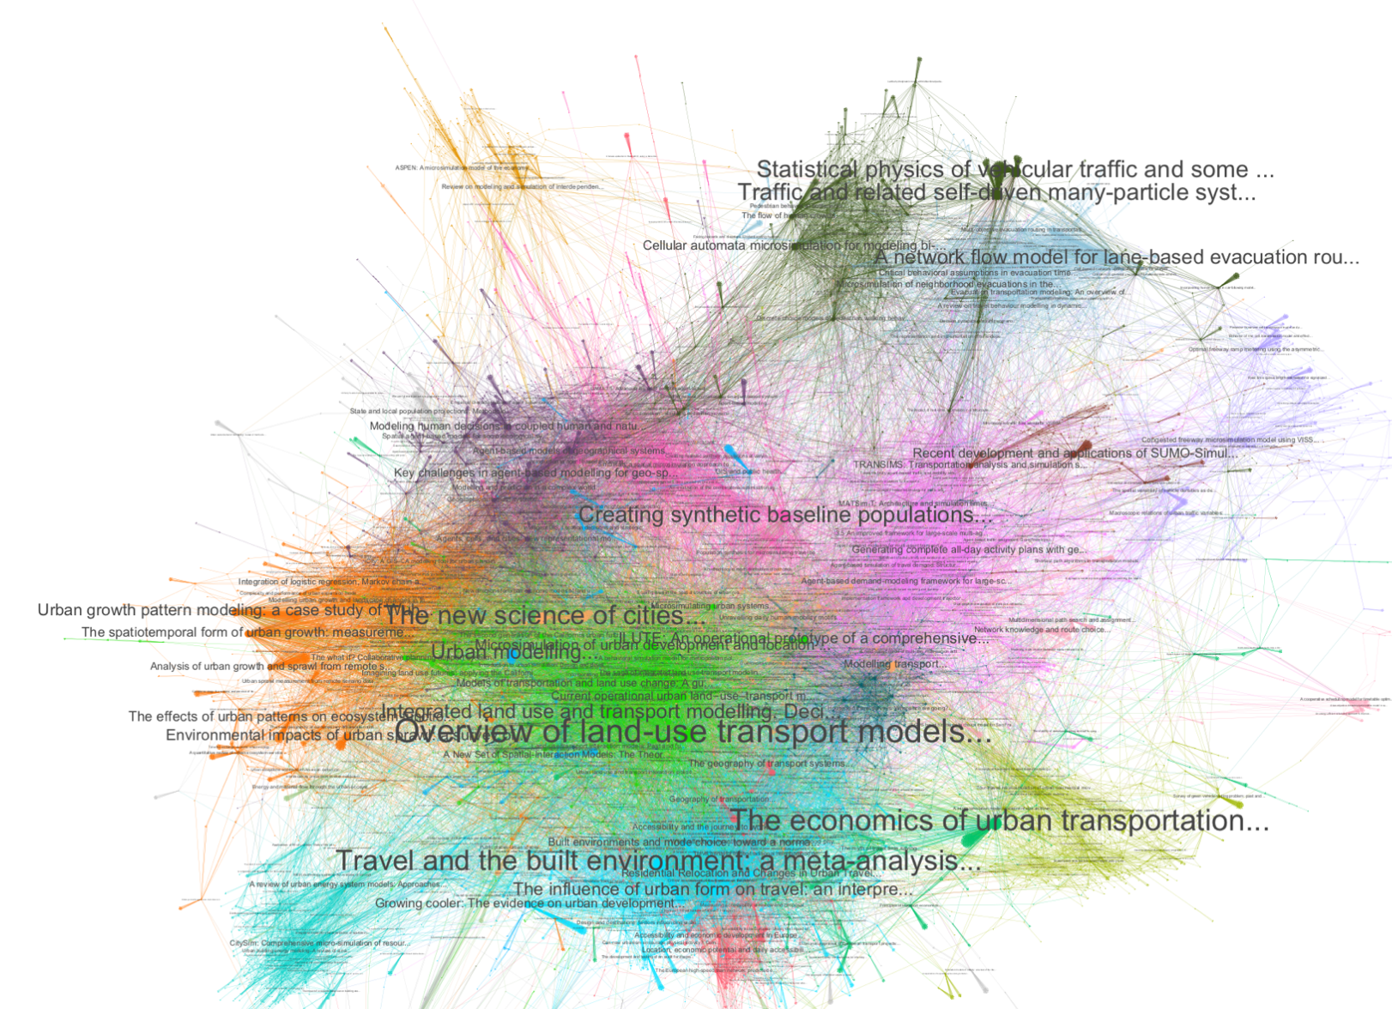
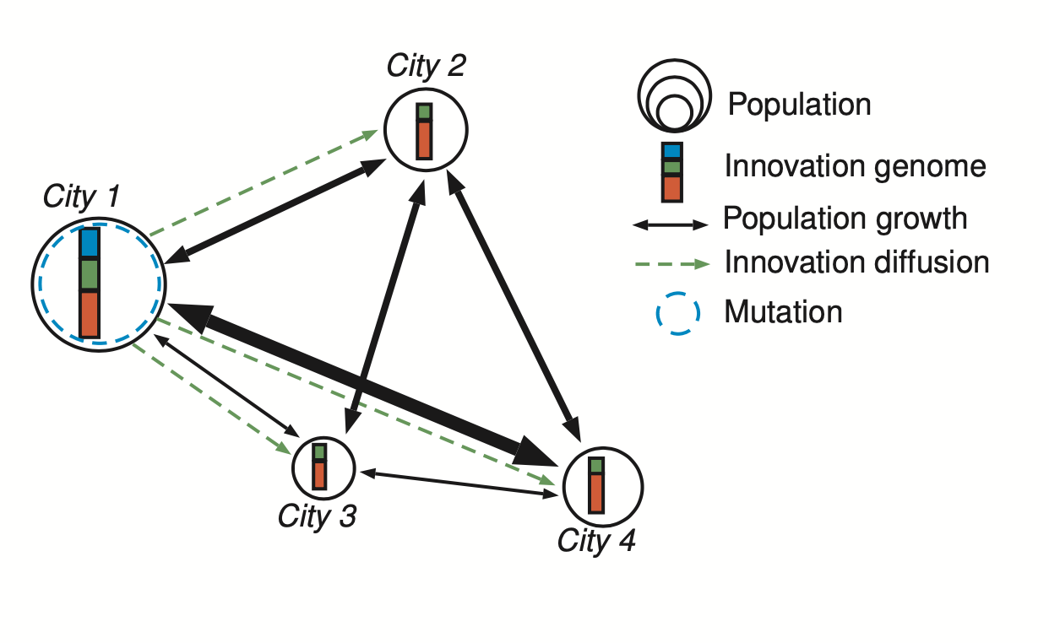
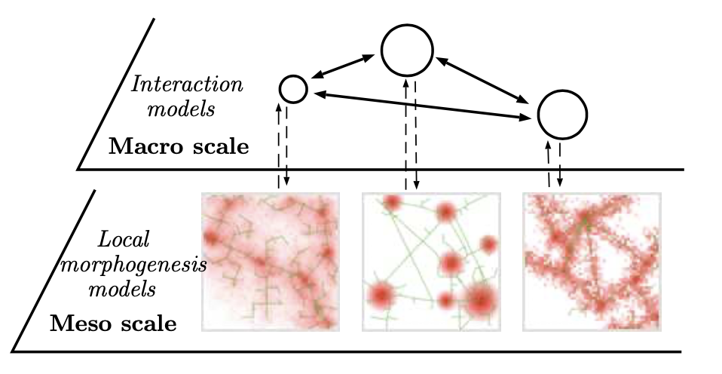
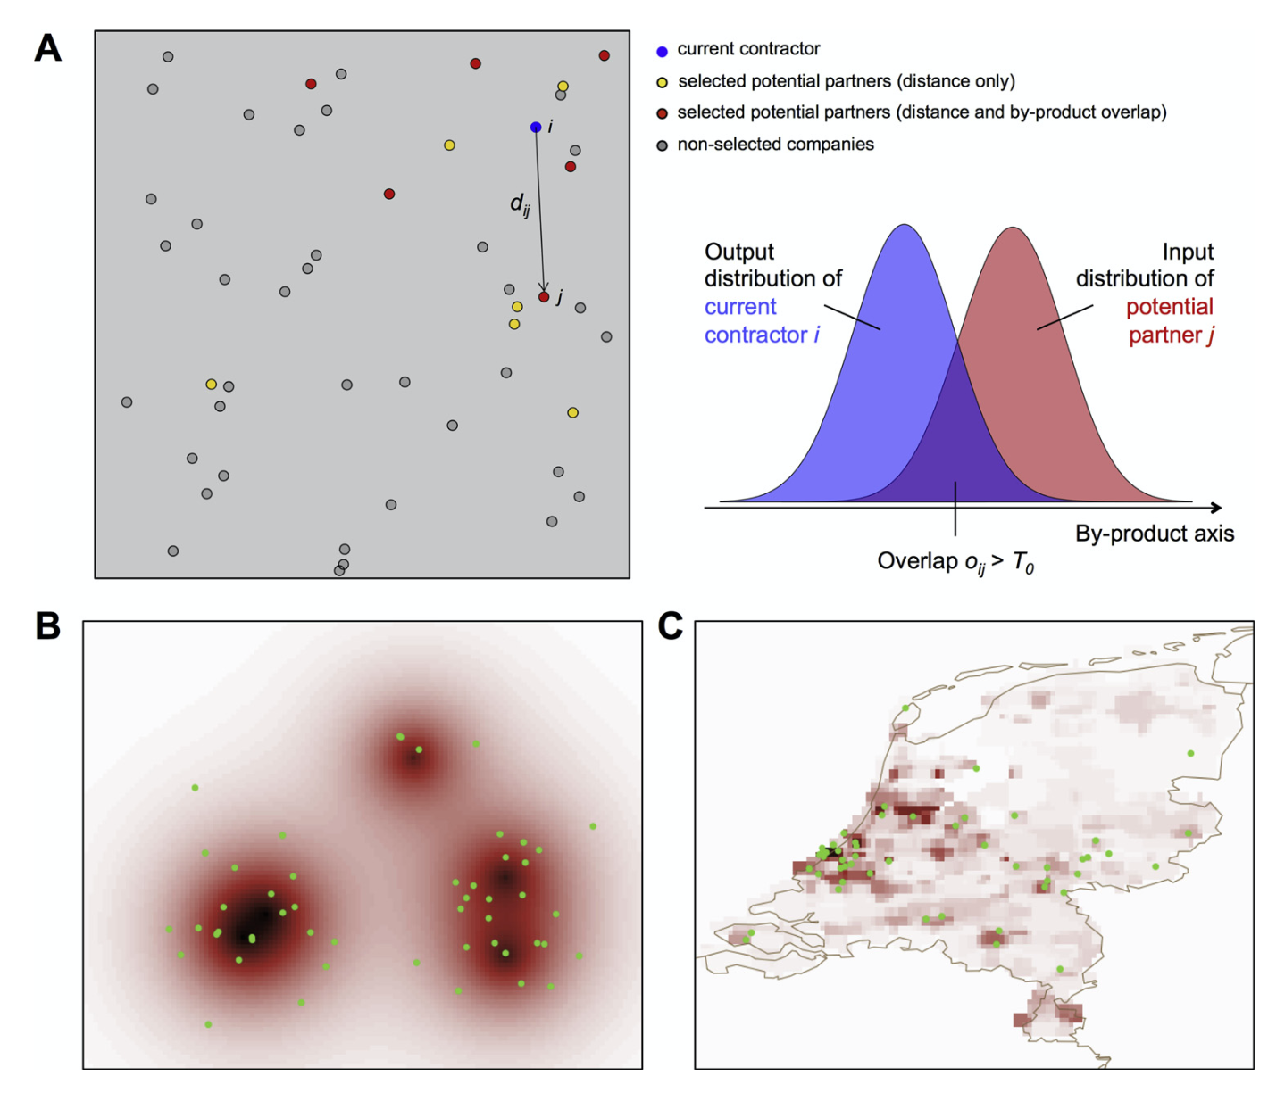
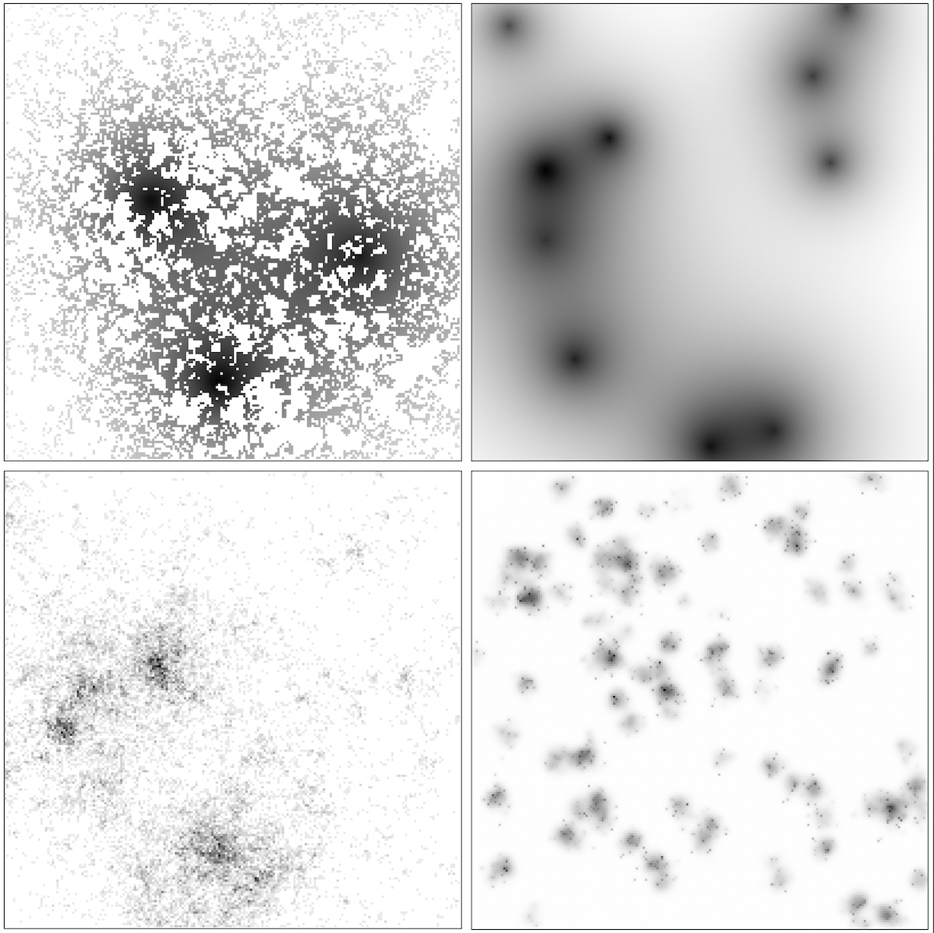
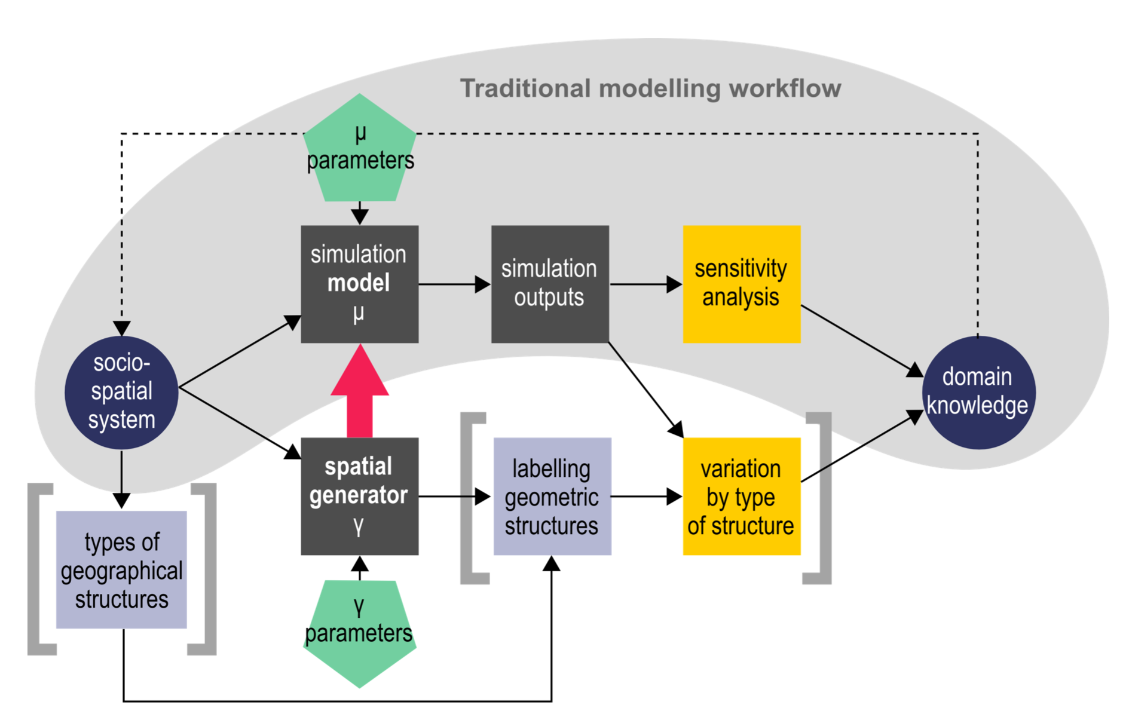


Juste Raimbault Research Fellow – Urban Dynamics Lab
Quantitative epistemology
Urban modeling
Evolutionary approach to systems of cities
Towards integrated multi-scalar urban theories and models
Land-use transport interactions / microsimulation
QUANT
SPENSER
MATSim
Citation and semantic networks, patents and innovation
Methodology
Urban morphogenesis
ABMs for sustainability
Model validation
Spatial sensitivity analysis
High performance computing

